Slide 1


Suptechnology Private higher education school of Engineering and Information Technology
End of year project
Conception and development of a 2d platformer game :
Run&Slash
Accomplished by:
WALID MAHBOUB
Academic year :
2024-2025
Supervised by :
ENAANAI ADIL

Slide 2
Presentation plan:
Game Idea
Why This Game?
Game Showcase
Gameplay Mechanics
Animations
Development Process
Struggles
What I used
What’s Next?
Questions?

Slide 3
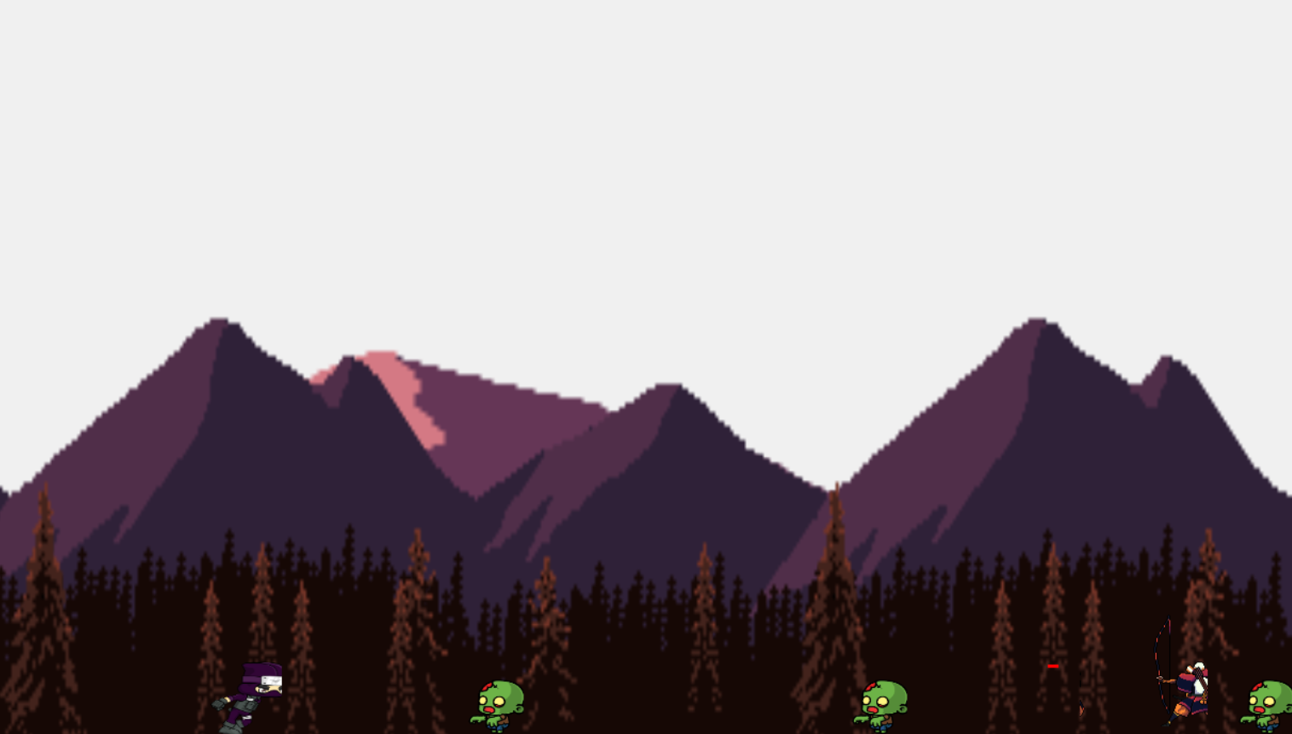
Game Idea:
Run&Slash is a simple 2D platformer where you play as a ninja slashing your way through zombies and archers.

Slide 4
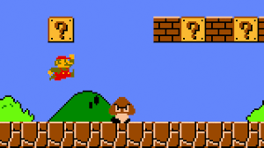
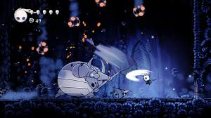
Why This Game?
Super Mario Bros Hollow Knight

Slide 5
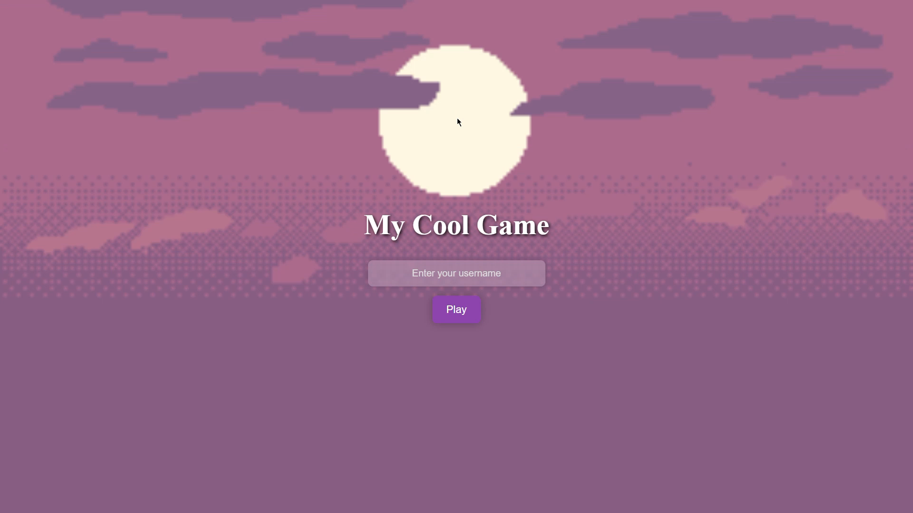
Game Showcase

Slide 6
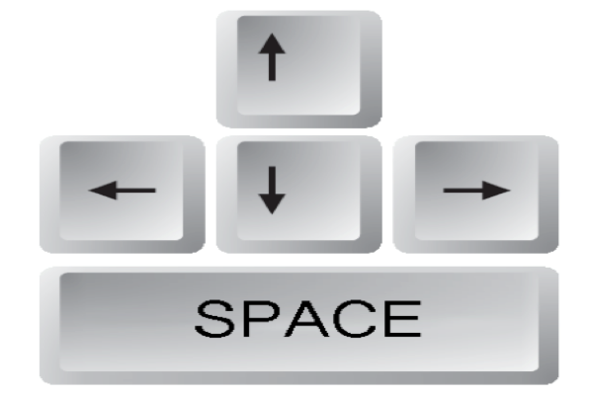
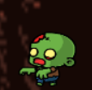
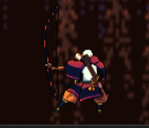
Gameplay Mechanics
→ =Go right
← =Go left
↑ =Jump
Space =Slash
Zombie: A slow, mindless enemy that walks straight toward the player and kills on contact.
🏹 Archer: A ranged enemy that stops after a few steps to load and fire deadly arrows at you.

Slide 7
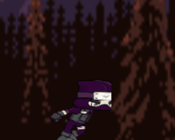
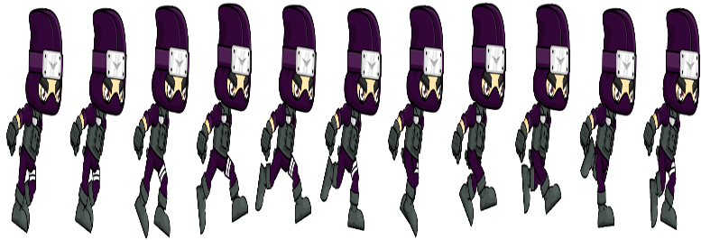
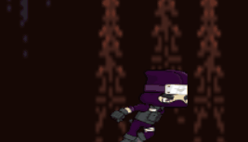
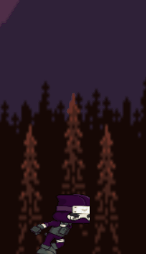
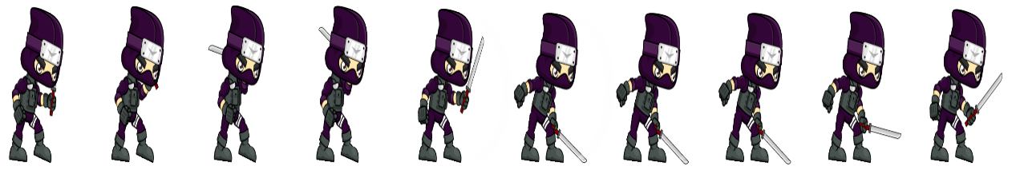
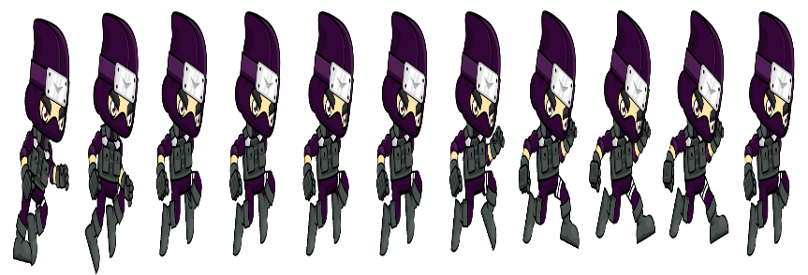
Animations & Sounds

Slide 8
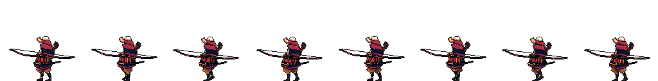
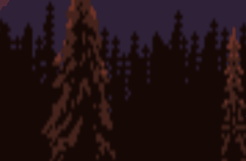
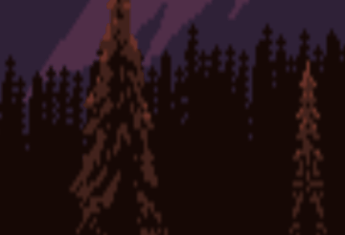
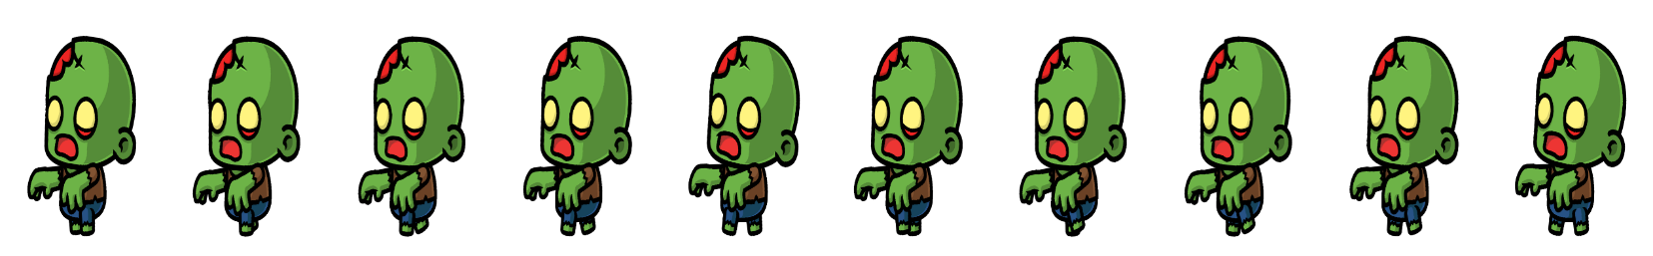

Slide 9
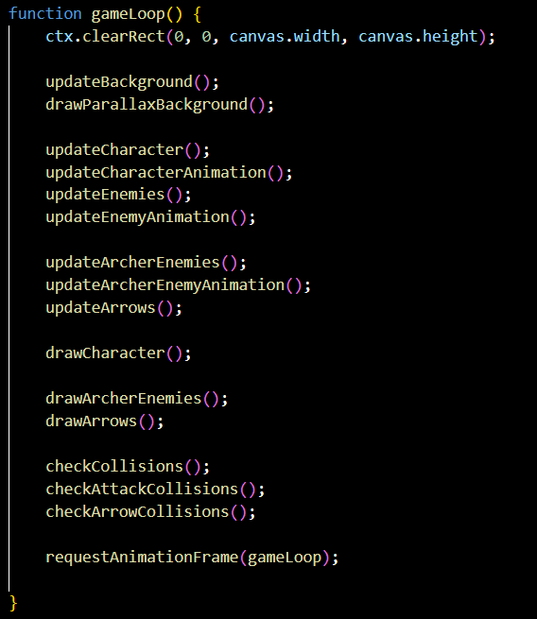
Development Process:
Order:
Parallax Backround
Character movement
Character animations
Zombie animation
Collisions
Archer animation
Sound effects
backround music
Start page, game over page
Lines of code :
815

Slide 10
Struggles:
First time using JavaScript for a full game
Animating sprites was very hard , learning from AI and YouTube
Frustration and laziness
Originally wanted to add more features but scaled down

Slide 11
What I used:
Pure HTML, CSS, JavaScript
No frameworks or libraries
Sprites, sounds, and music all found online
Tested the game in a regular browser

Slide 12
What’s Next?
Not going to keep working on this exact version
Planning to remake a better version in Godot
Add scoring, more enemies, maybe even guns
Now actually interested in game dev — this was just the start

Slide 13
Thanks for watching my presentation. I hope you enjoyed Run&Slash as much as I enjoyed making it!
Any questions?

